Slide 1

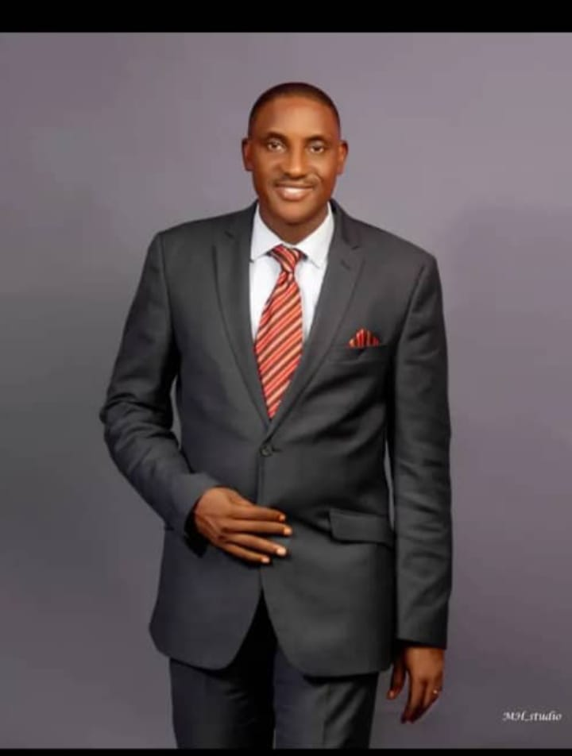
COURSE CODE: TMC 411
Landmark University
GOD-CONFIDENCE AND SELF CONFIDENCE
PRESENTED BY:
Pastor. Obed Onos
Sec. BOR and Chaplain, Landmark University

Slide 2
Introduction:
God created human beings to be unlimited. Their performance, however, will be determined by how much they know themselves and manage their relationship with God.
While we need to believe in ourselves and have confidence in our abilities, self-confidence has a potential risk: it may teach us that we can do things on our own outside of God's help. John 15:5
Self-confidence teaches us to rely on ourselves whereas God-confidence teaches us to rely on God. Hebrews 12:2

Slide 3

GOD-CONFIDENCE AND SELF-CONFIDENCE
WHAT IS SELF-CONFIDENCE ?
A realistic confidence in one’s own judgment, ability, and power.
An excessive or inflated confidence in one’s own judgment or ability. In any event, it’s all about me no you.

Slide 4

WHAT IS GOD-CONFIDENCE?
God-Confidence is about depending absolutely on God and His strength to handle the things in your life. Dan 2:28, Dan 11:32, Dan 3:17

Slide 5

HOW TO BUILD OR DEVELOP GOD-CONFIDENCE
1. A strong and consistent Personal Relationship with Jesus
The first step in God-confidence is a personal relationship with Jesus Christ.
Once you have a personal relationship with the Lord then the journey has begin. John 15:7

Slide 6

2. Bank on God’s Promises
We must depend on God’s promises.
I can do all things through Christ which strengthened me. Phil 4:13
But my God shall supply all your need according to his riches in glory by Christ Jesus”. Phil 4:19

Slide 7
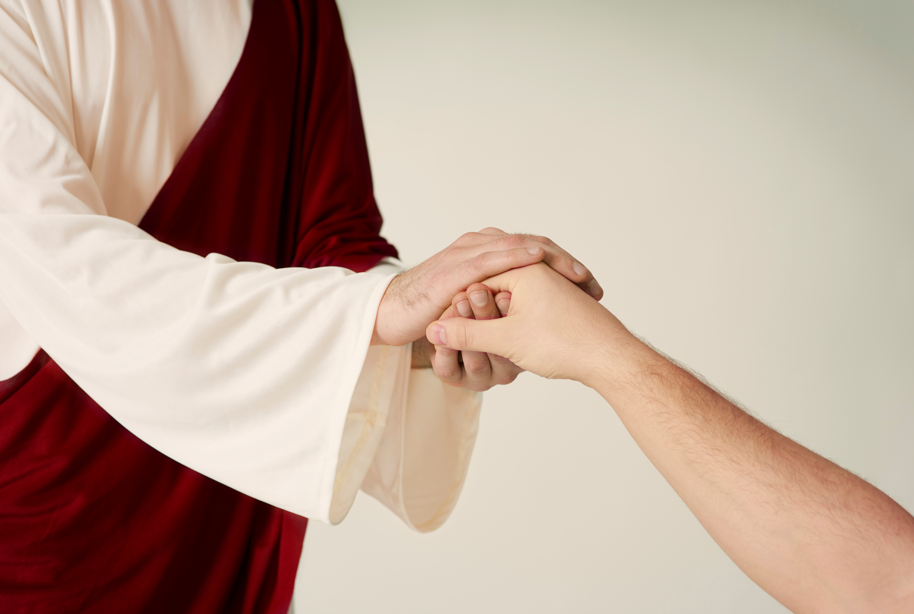
3. Rely on the approval from God
It’s also important to remember that our worth doesn’t come from our actions, what we look like, or how much money we have. Instead, our worth lie in God.
He created us for His honor and glory and for His pleasure.

Slide 8
4. Identify your confidence killers
Control/Circumstances We think if our circumstances change, then we’ll be confident (health, finances, dating, marriage, job). Prov. 28:26
Money – We think more money will bring confidence. 1 Tim. 6:17
Achievement - We think accomplishing goals in work or life will bring confidence. 1 Cor. 15:10

Slide 9
People – We think people liking us or respecting us will bring confidence. Prov 25:19, Prov. 29:25
Pleasure – We think feeling pleasure will give us confidence. Eccl 2:1-11

Slide 10
5. Pray to God boldly
David was gut-level honest with God. Ps 31:10, 14-16
We have to rely on Him, and that means putting everything we think and feel out into the open.
Knowing the nature of your flaws, fears, insecurities, and weakness, make you feel inferior inside then you need help.

Slide 11
6. Absolute obedience to God’s instructions
God’s word is powerful, and even just reading it builds faith, but the real confidence comes from applying it. Rom 10:17.
But don’t just listen to God’s word. You must do what it says. Otherwise, you are only fooling yourselves.
For if you listen to the word and don’t obey, it is like glancing your face in a mirror and for getting who you are. James 1:22-25

Slide 12
7. Develop confidence in your daily activities
Do not get tired of doing what is good. At the right time we will reap a harvest of blessing if we don’t give up.
Whenever we have the opportunity, we should do good to everyone—especially to those in the family of faith. Galatians 6:7-10 NLT
When you live life God’s way, he comes through for you, helps you grow, and guides you to do good for other people

Slide 13
In conclusion
When we are close to God, we have the confidence to share our life, give generously, and sacrifice to help others.
We must ensure we rely on God to help us in the journey of life even as we advance from Landmark University.

Slide 14

In conclusion contd.
“I have strength for all things in Christ Who empowers me [I am ready for anything and equal to anything through Him Who infuses inner strength into me; I am self-sufficient in Christ’s sufficiency in Christ’s sufficiency]” Philippians 4:13 (AMP).

Slide 15
Thank You
For
Listening.

